Slide 1

Small Angle Scattering Analysis Toolkit

Slide 2
Agenda
Debunk the myth of the SasView project
Some project history
CURRENT status of the project and how everyone here has a part to play
A review of the relatively rich resources available in the SasView universe
Answers to a few questions received

Slide 3
Reality check
Myth:
SasView is a well-funded, professionally run organization and project
Reality:
There is no official "organization"
Usually no explicit funding
Few if any whose job specifically requires them to work on SasView
The volunteer army

Slide 4
2. Some History

Slide 5
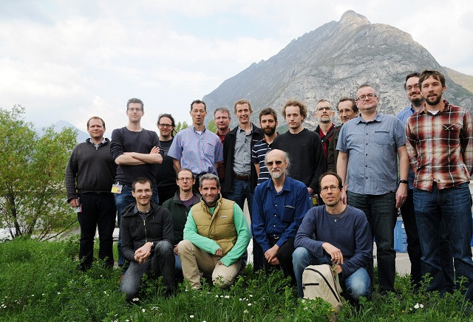
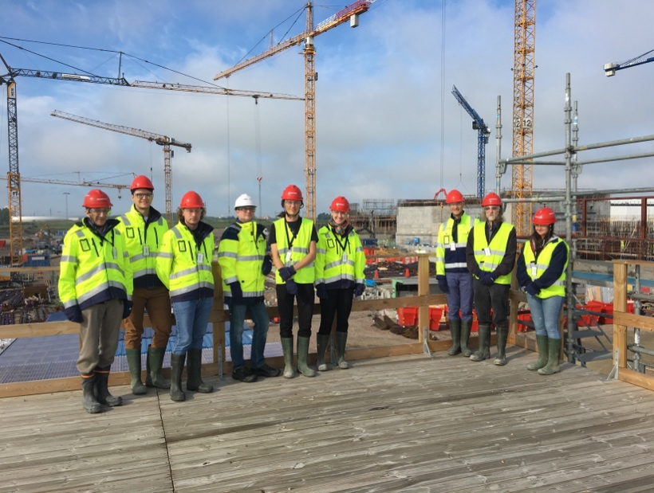
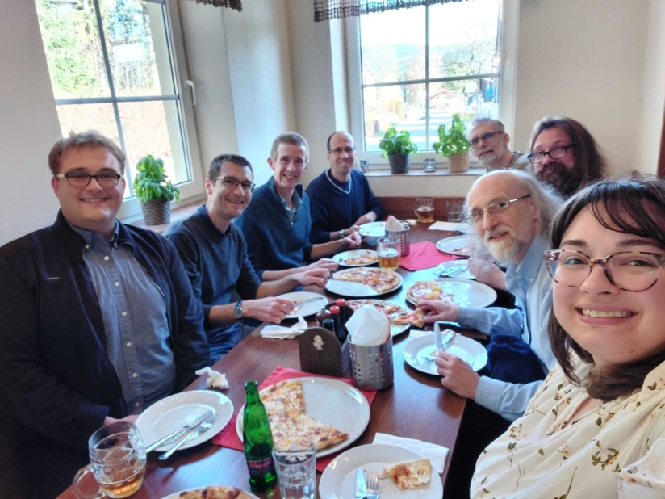
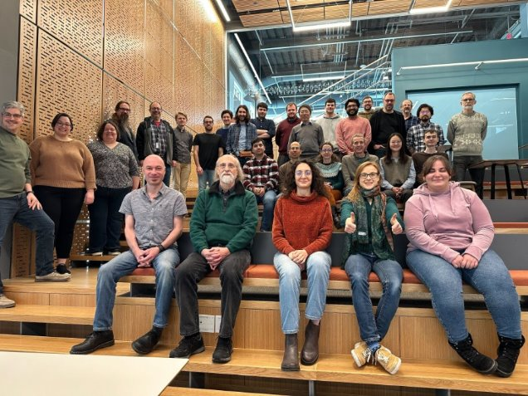
Some History
2006; originates in NSF DANSE project as SansView
2013; transitions into a community project
First Code camp at NIST April 2013
2015; move to github and release 3.0
2015; rename to SasView – Words matter
2016; Sine2020 project funded through ESS
2016; release 4.0 in October
2019; release 5.0 in May
2020; Essentially a “volunteer army”
2020 – PANDEMIC
2024; release 6.0
Pictures from Camps: VI, VIII, X, XII
www.sasview.org

Slide 6
Some History
SINCE TRANSITIONING TO THE COMMUNITY
Code camps: every year (twice in 2016, 2017)
NIST, ISIS, ESS(DMSC), Delft, SNS,ILL/ESRF, ESS/DMSC, ESS/Lund, ILL/ESRF,
2020 = Caltech code camp cancelled due o pandemic
Small camps 2022 and 2023 (poland; ISIS)
2023; Rebranded to Contributor Camp – Words matter
Jan 2024 Contributor camp at U. Del.
Pictures from Camps: VI, VIII, X, XII
www.sasview.org

Slide 7
3. Current Status

Slide 8
Current Status of SasView
80+ contributors from 15 organizations, including 6 Universities so far and growing (~10-15 active at any one time)
1 to 2 releases/year (6.1.1 JUST RELEASED)
Documentation/tutorial projects ongoing
Usage? Seems to be "everywhere?"
Lots of "complements" (a bit scary)
Publications? > 100/year ?
SasView is an aspirational project
Pictures from Camps: VI, VIII, X, XII
www.sasview.org

Slide 9
The SasView Aproach
An
“open, collaborative, community development”
platform for
Small Angle Scattering Data Analysis

Slide 10
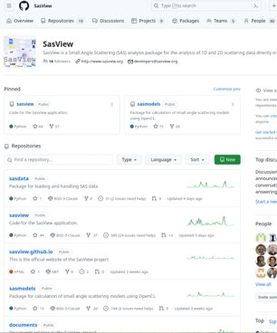
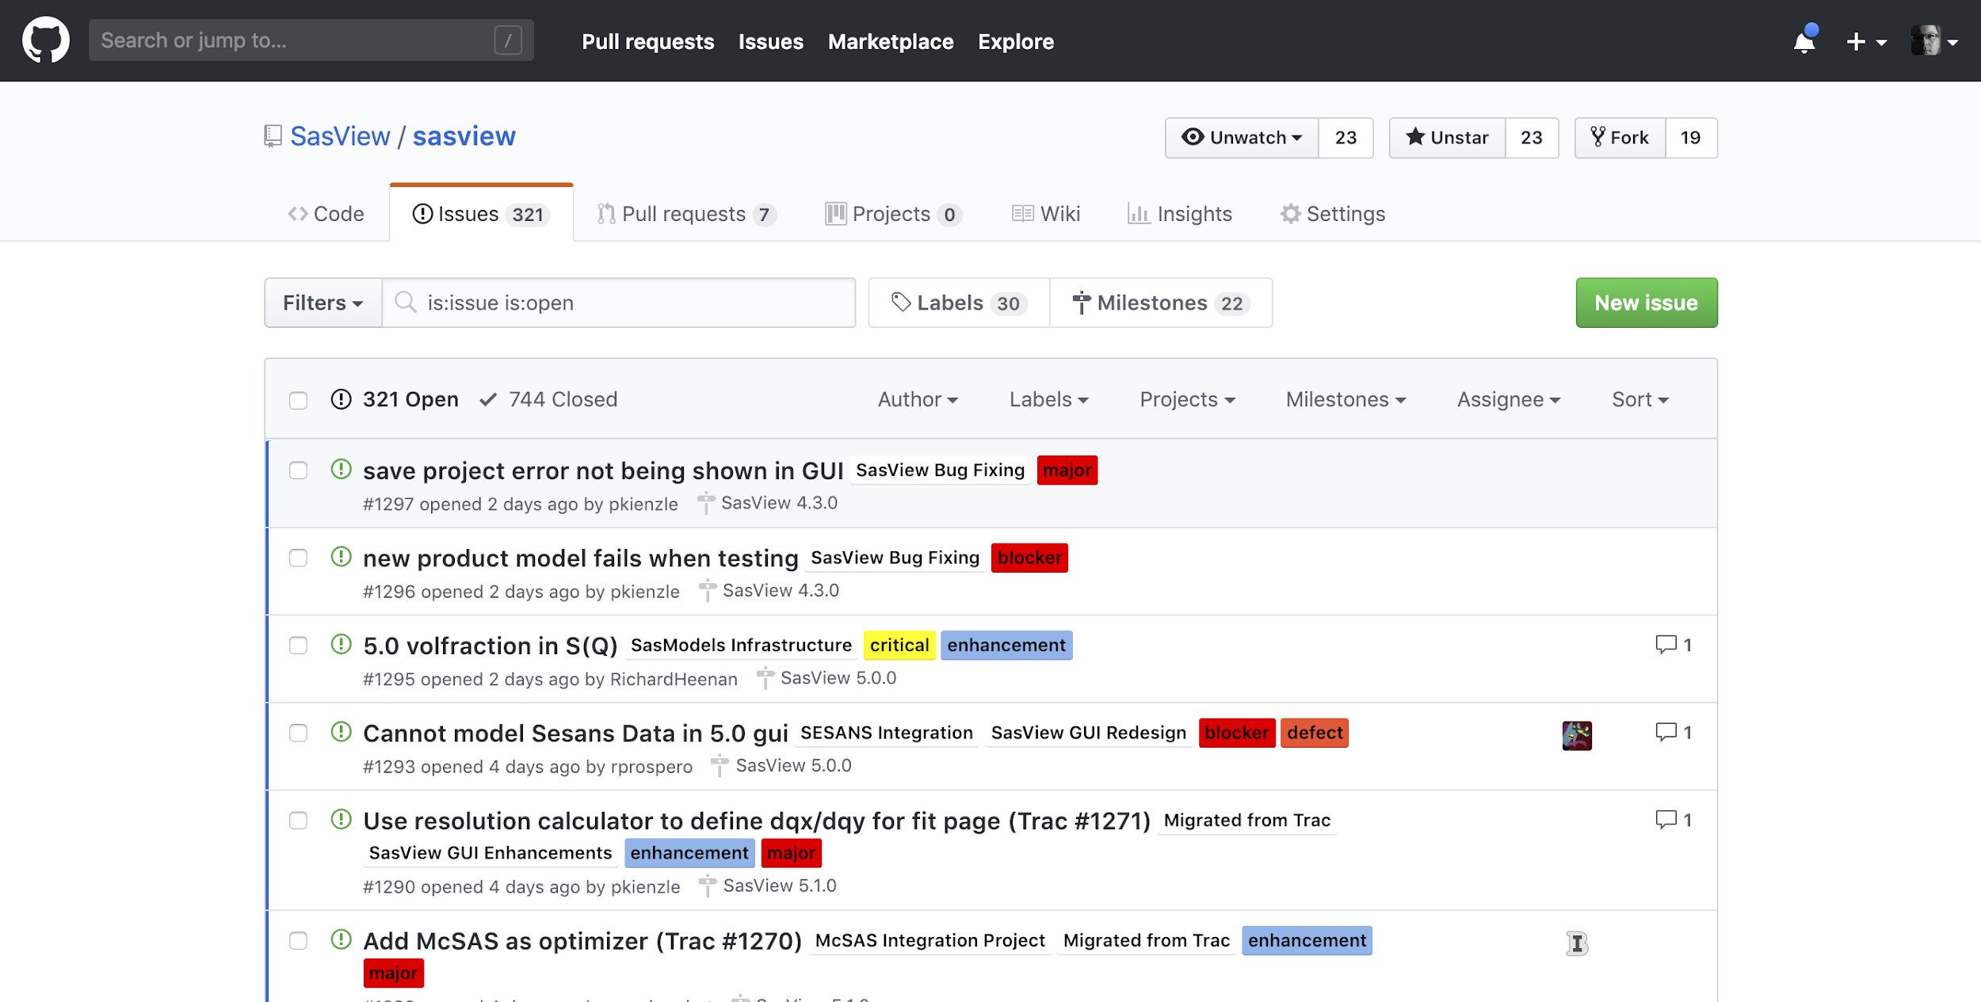



Open, Collaborative, Community Development
Code is open source and publicly hosted at Github
Released under BSD 3-clause license
(Zenodo) DOI for each release
Code Hosting, Issue Tracking, Developer Wiki & CI on Public Github repos
Rolling 5 Year Roadmap
https://www.sasview.org
https://github.com/SasView

Slide 11
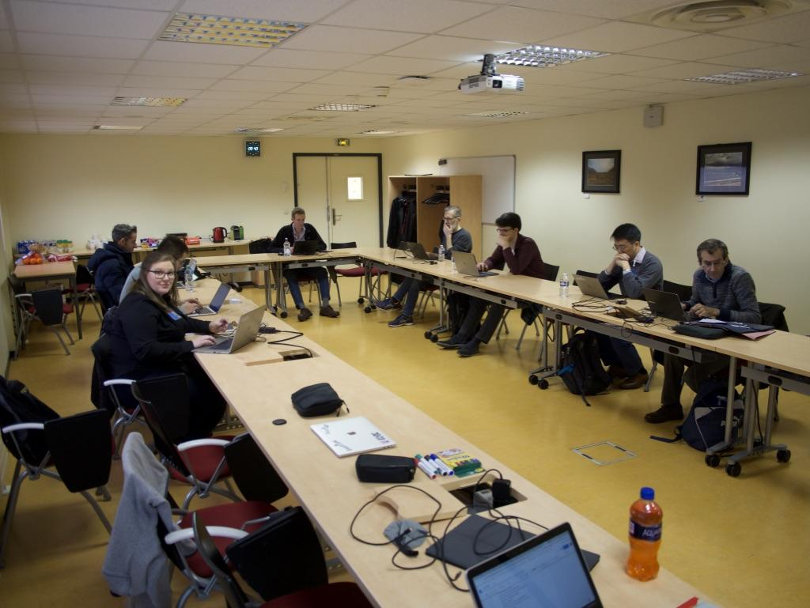
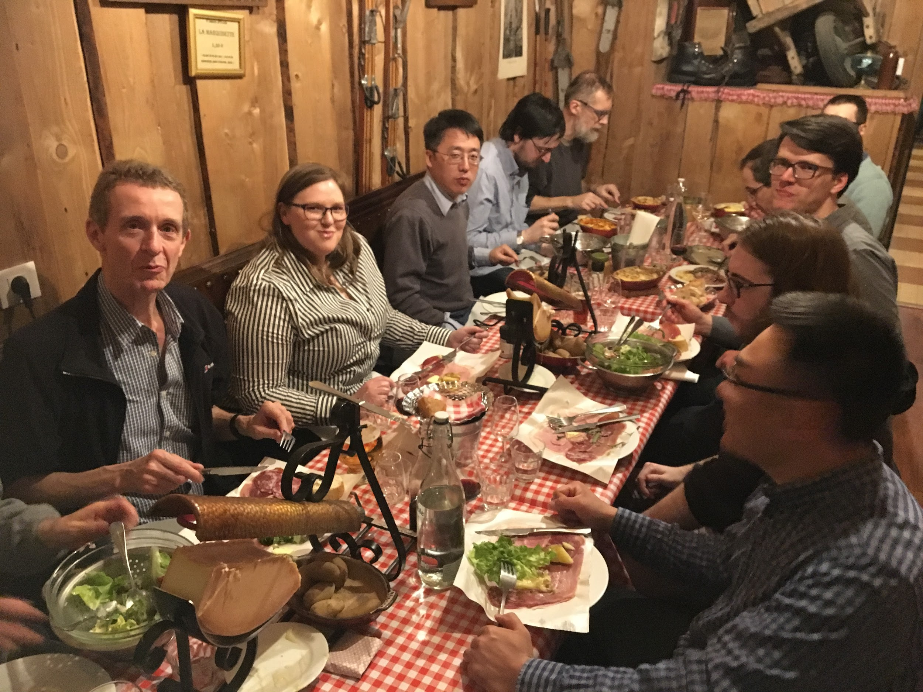
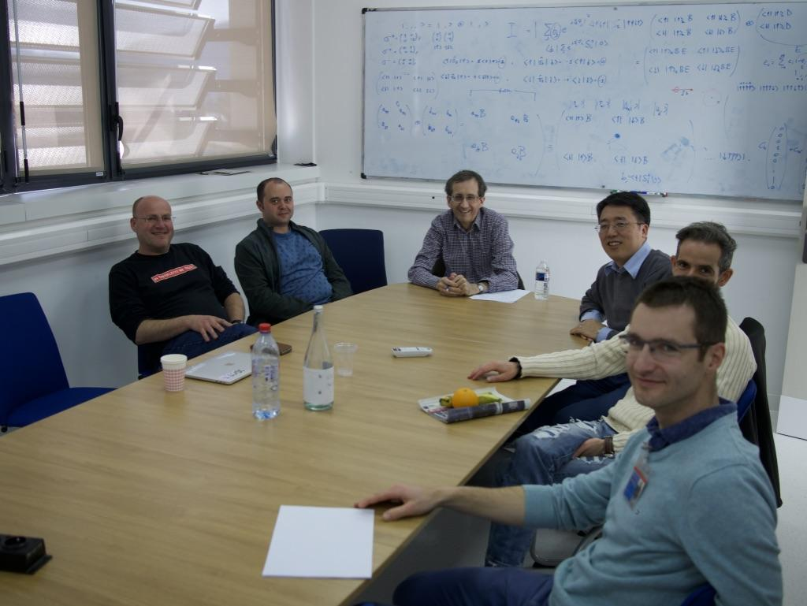
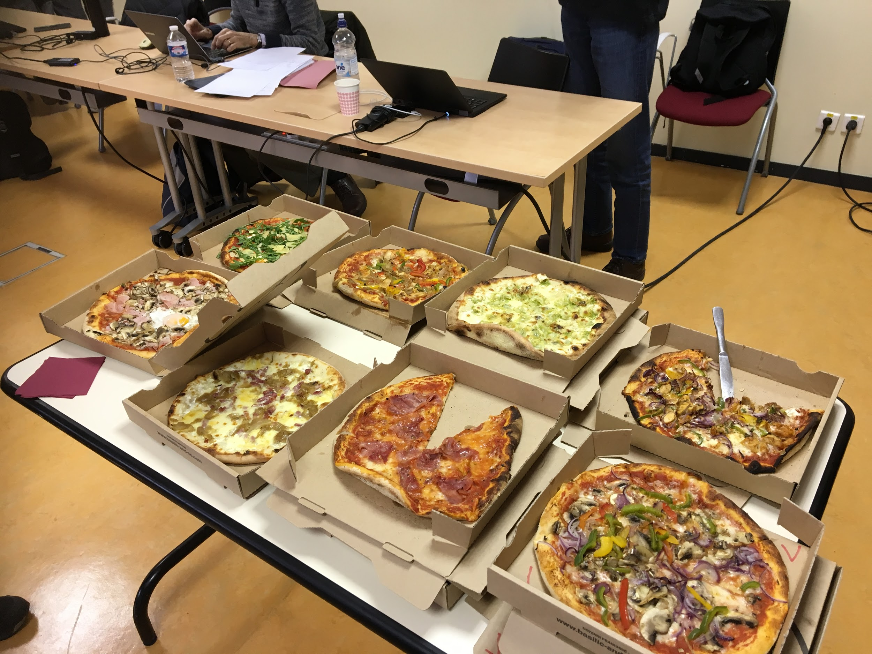
Open, Collaborative, Community Development
Twice monthly zoom calls
Regular ‘camps’ & ‘hackathons’
Developer's mailing list
SasView slack
Expertise sharing and helping
Small leadership team to facilitate
Collaboration also builds
Community
http://www.sasview.org
http://github.com/SasView

Slide 12
Community Development Rules
Open, Collaborative, Community Development
No MOU ... all are invited and welcome​
Two Basic Rules:
Those who bring the resources (time, effort, funds) choose what to work on
but cannot break existing experiences ...

Slide 13

What will SasView do in the future?
Whatever the community contributes. (That's YOU)
Ask not what the community is going to do for you, ​
ask what you can do for the community​
The community needs you
Ask not what the community is going to do for you,
ask what you can do for the community
Ask not what the community is going to do for you,
ask what you can do for the community
Ask not what the community is going to do for you,
ask what you can do for the community
Ask not what the community is going to do for you,
ask what you can do for the community

Slide 14
Contributing to SasView
You don’t have to be coding ninja to contribute!
Respond to queries posted to help@sasview.org or github
Teach others how to get the best from SasView
Write and improve documentation
Write and record tutorials
Test SasView (over and over!) and write bug reports
Provide new plugin models
Deploy and improve automated testing
Review the code contributions of others
Develop code in Python3/C and PySide2/Matplotlib
Server and Github admin task
Develop/improve databases (e.g. marketplace) etc.
www.sasview.org/contribute

Slide 15
4. A review of resources

Slide 16

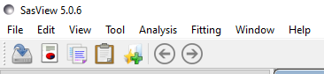

SasView Toolkit for SAS data Analysis
Tools
Perspectives on the data
Data Operation
SLD calculator
Density/Volume calculator
Slit Size Calculator
Kiessig Thickness Calculator
Q Resolution Estimator
Generic Scattering calculator
Orientation Viewer
Python Shell/Editor
Image Viewer
File Converter
Analaysis
Fitting
Invariant
Pr Inversion
Correlation Function

Slide 17
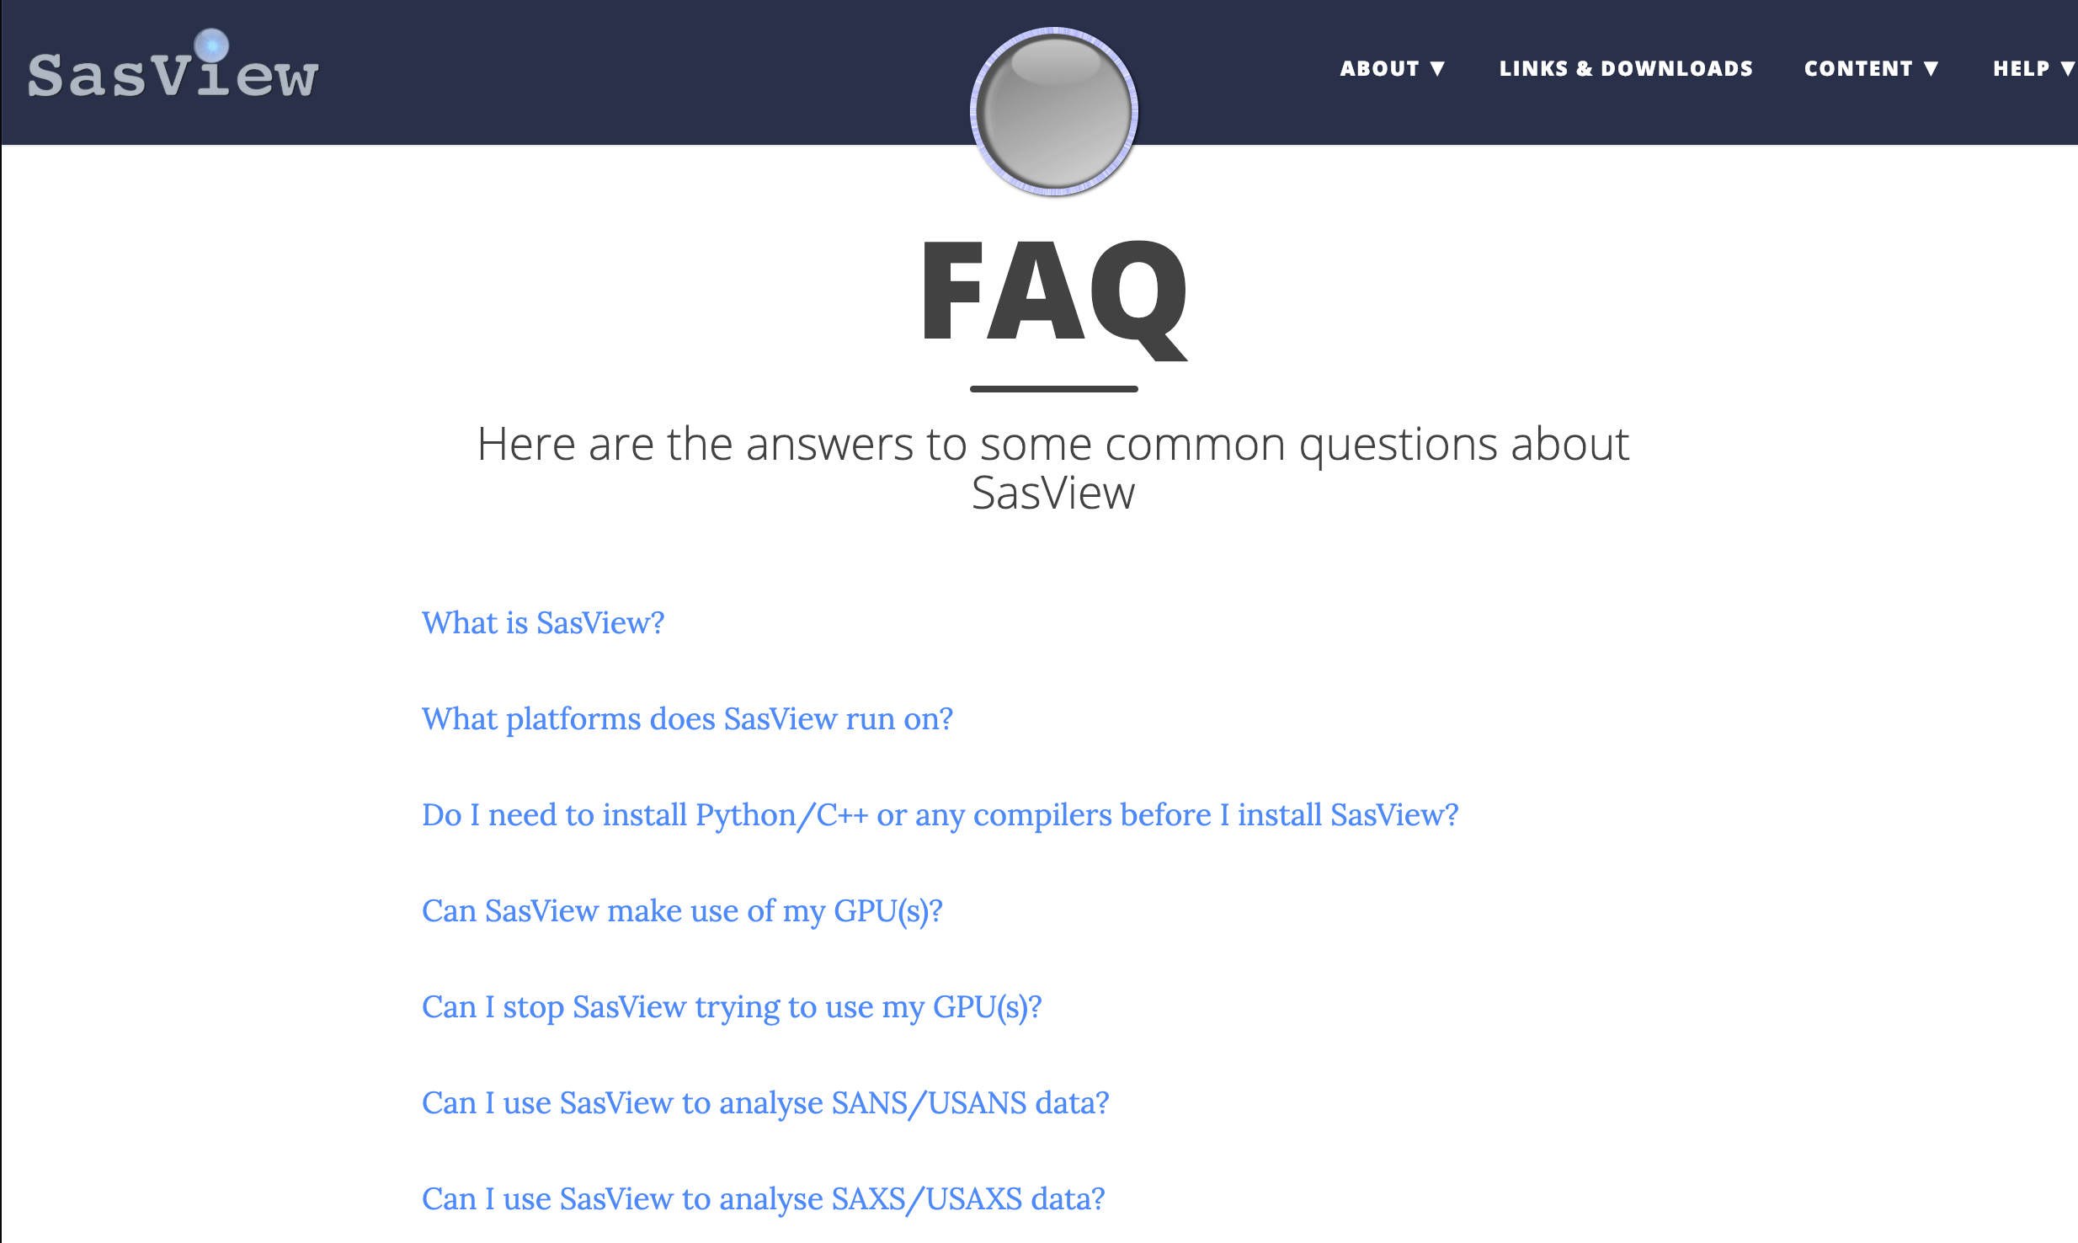
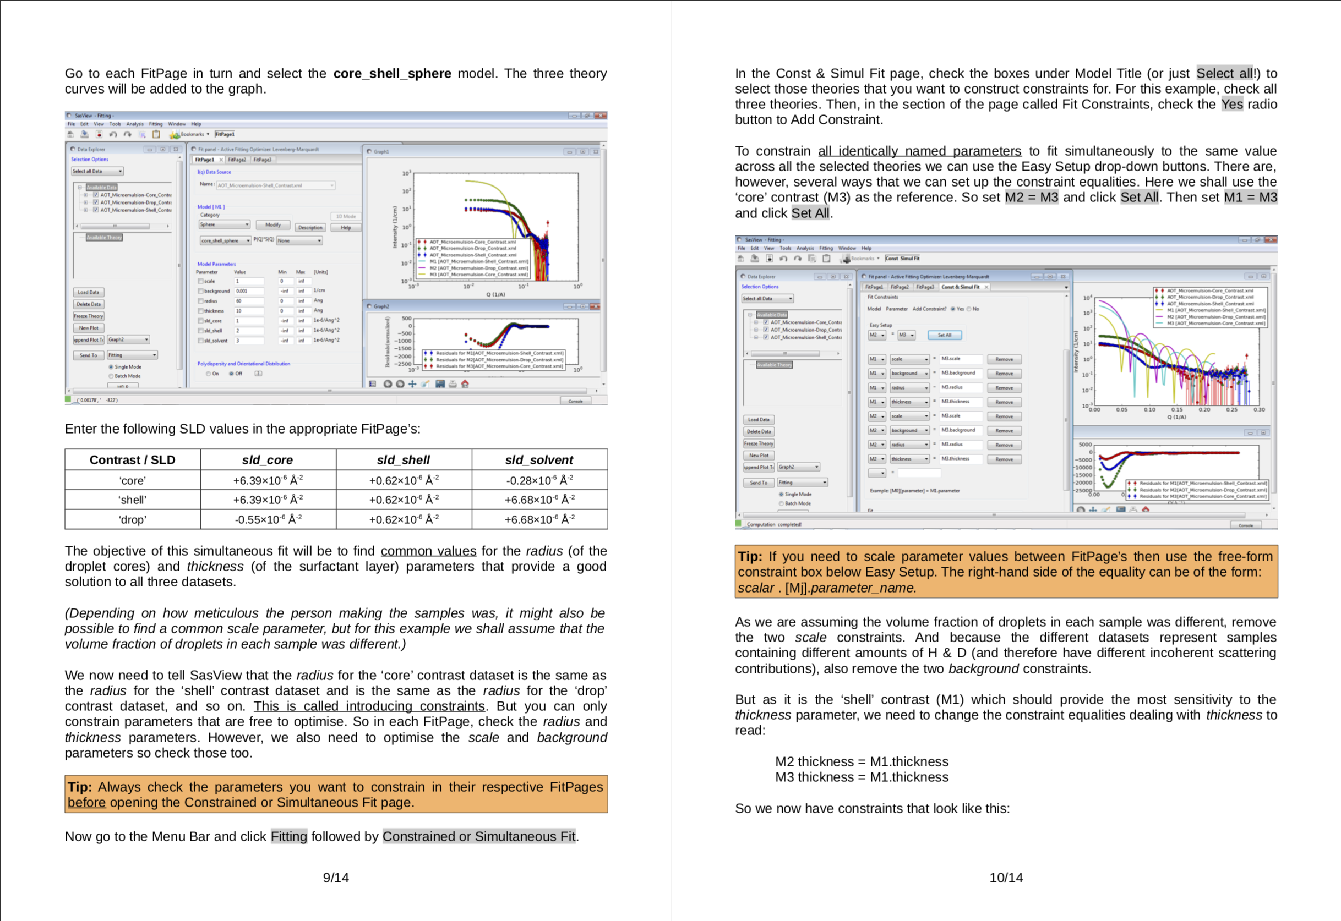
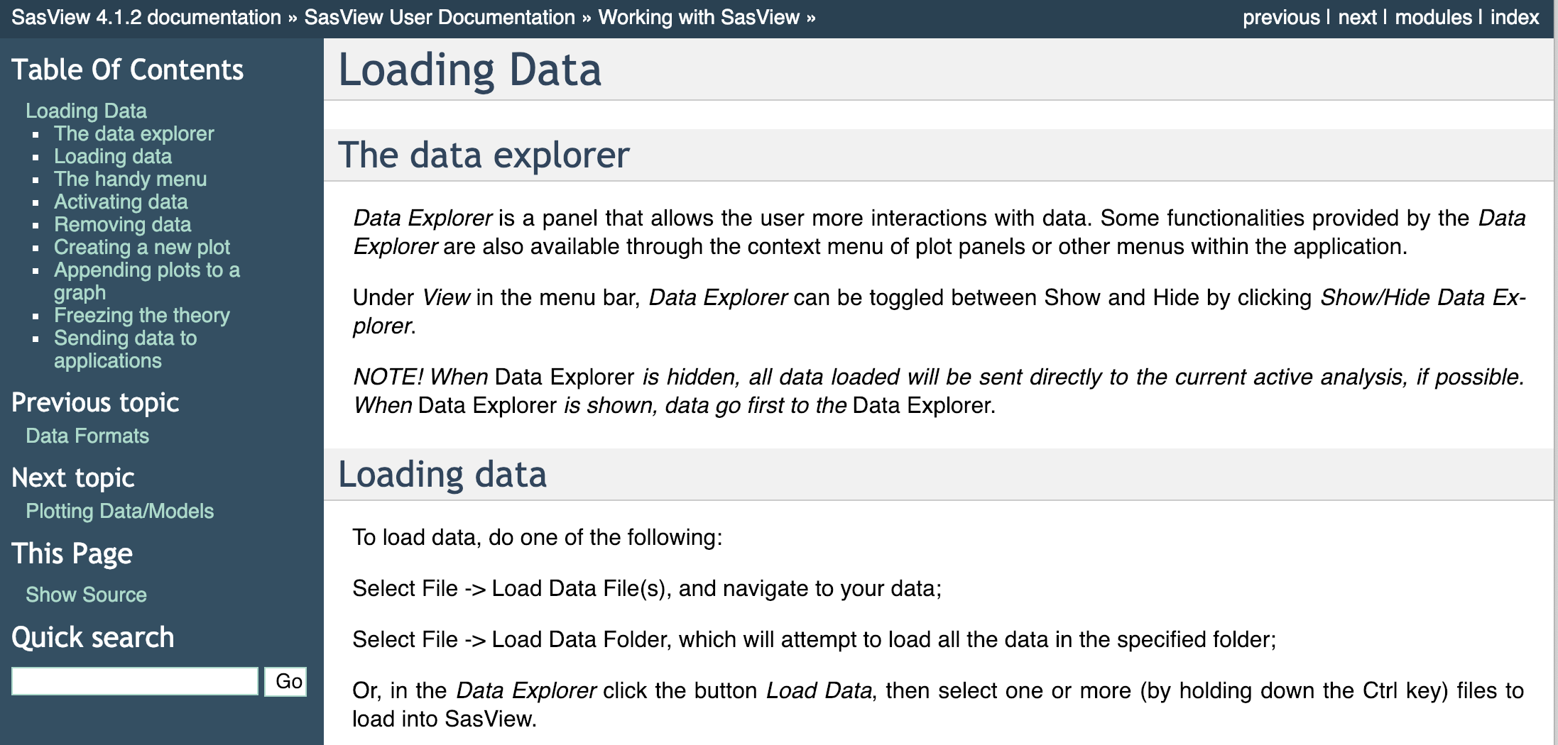
Resources, Education & Outreach
Website
Documentation
Written Tutorials
Video Tutorials (YouTube)
Taught courses
Scattering schools
University courses
E-learning
Twitter Linkedin
Slack
Mailing Lists
Bootcamps & Regional Workshops
(Marketplace)

Slide 18
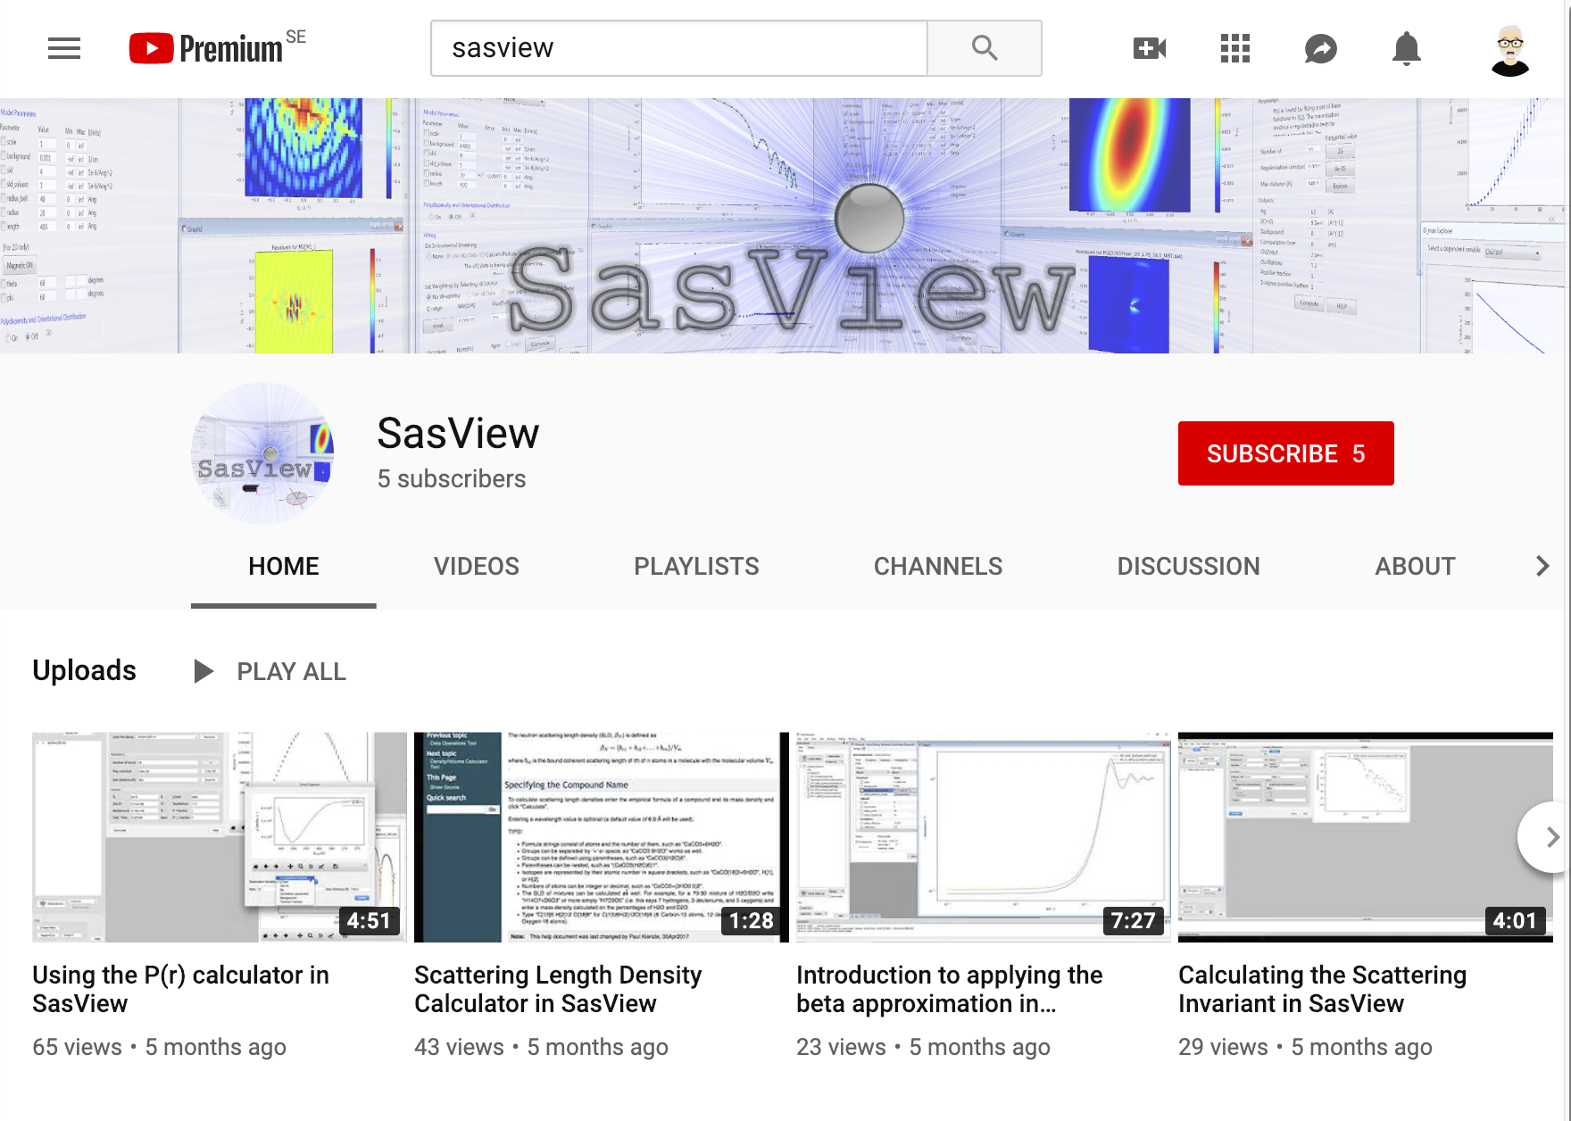
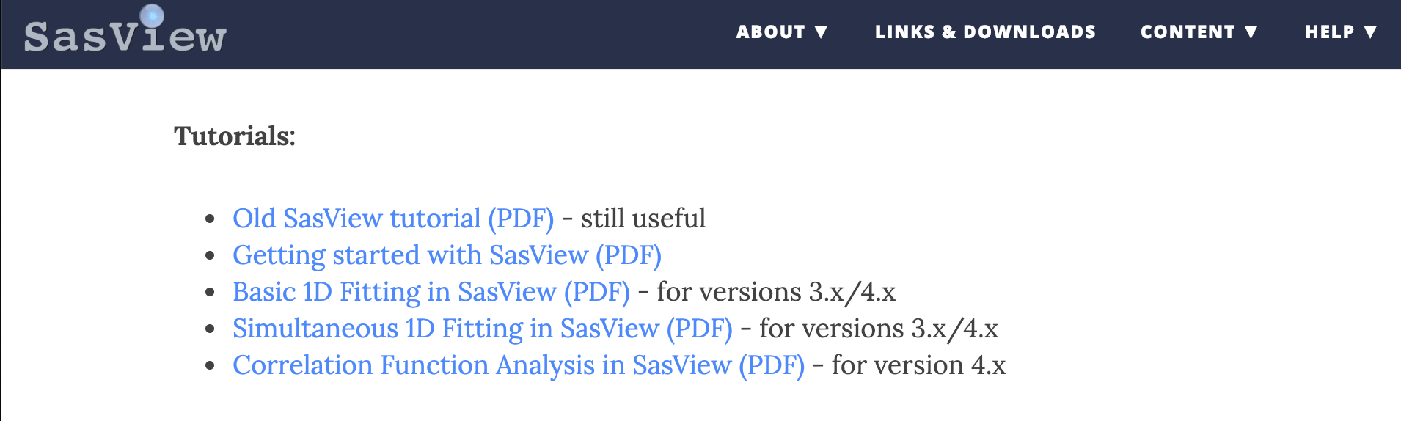
Resources, Education & Outreach
Website
Documentation
Written Tutorials
Video Tutorials (YouTube)
Taught courses
Scattering schools
University courses
E-learning
Twitter
Slack
Mailing Lists
Bootcamps & Regional Workshops
(Marketplace)

Slide 19
Resources, Education & Outreach
There are a lot and you may forget where to find them
Website
Documentation
FAQ
Written Tutorials
Video Tutorials (YouTube)
E-learning
Twitter Linkedin
Slack
Help and User lists
Developer lists
Bootcamps & Regional Workshops
Model Marketplace
Github: code, wiki, issues and discussions
ONE LINK TO RULE THEM ALL
www.sasview.org

Slide 20
5. Answers to a few pre-posed questions

Slide 21
RESPONSE TO SOME QUESTIONS
QUESTION:
Is it possible to convert nm⁻¹ into Angstrom⁻¹

Slide 22
RESPONSE TO SOME QUESTIONS
QUESTION:
How can I fit SAS data sequentially with specific parameters varying
How can I then plot of that parameter w.r.t file number etc

Slide 23
RESPONSE TO SOME QUESTIONS
QUESTION:
How can I co-refine SANS and SAXS data (fitting one model simultaneously to SAXS and SANS data?)

Slide 24
RESPONSE TO SOME QUESTIONS
QUESTION:
^{OTHERS: ….....}

Slide 25
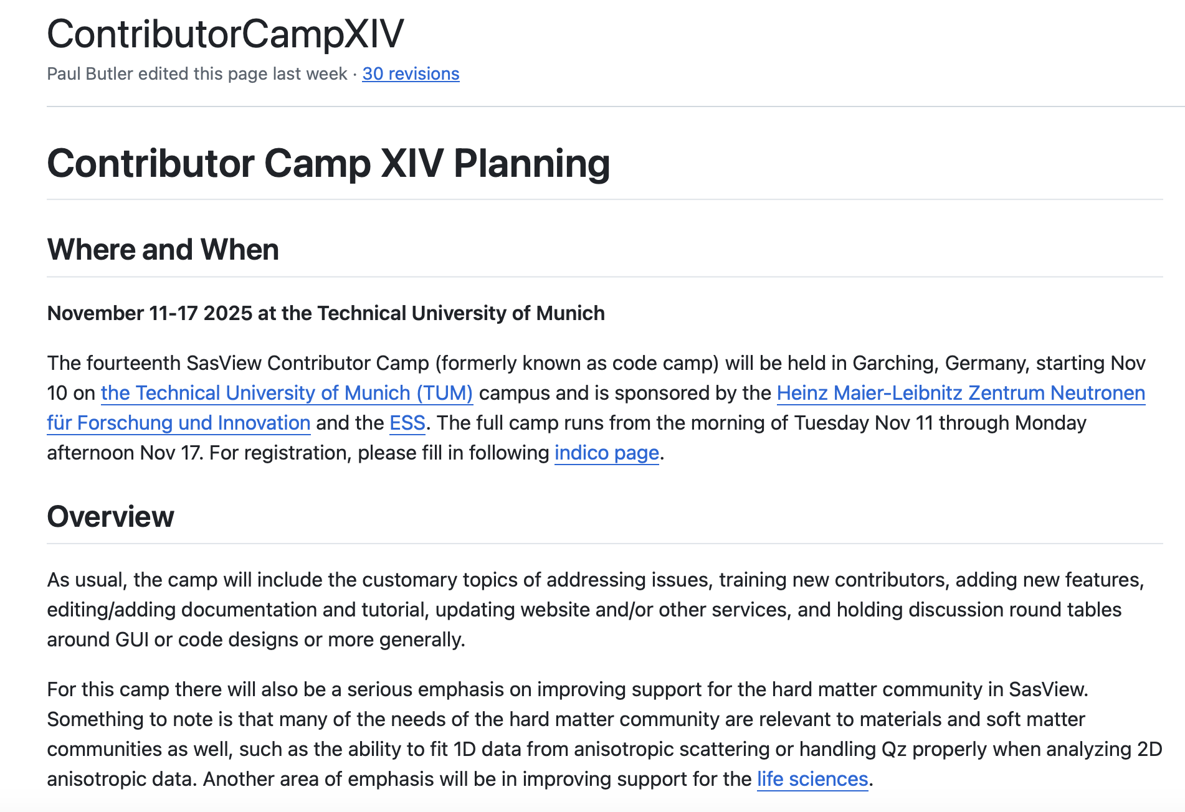
ONLY ~ 2+ WEEKS AWAY

Slide 26
Contributing to SasView
You don’t have to be coding ninja to contribute!
Respond to queries posted to help@sasview.org or github
Teach others how to get the best from SasView
Write and improve documentation
Write and record tutorials
Test SasView (over and over!) and write bug reports
Provide new plugin models
Deploy and improve automated testing
Review the code contributions of others
Develop code in Python3/C and PySide2/Matplotlib
Server and Github admin task
Develop/improve databases (e.g. marketplace) etc.
www.sasview.org/contribute

Slide 27
What will SasView do in the future?
Whatever the community contributes. (That's YOU)
Ask not what the community is going to do for you, ​
ask what you can do for the community​
The community needs you
Ask not what the community is going to do for you,
ask what you can do for the community
Ask not what the community is going to do for you,
ask what you can do for the community
Ask not what the community is going to do for you,
ask what you can do for the community
Ask not what the community is going to do for you,
ask what you can do for the community

